Slide 1

Water Safety Workshop
Notes:
Introductory slide: Water Safety Workshop for the Primary Level

Slide 2
Notes:
Introduce the Water Safety Scotland, three-step Water Safety Code:
Stop and think, spot the dangers
Stay together, stay close
In an emergency, call 999
There will be opportunities throughout the workshop to discuss the three-step code which is designed to keep people safe when in and near water.

Slide 3
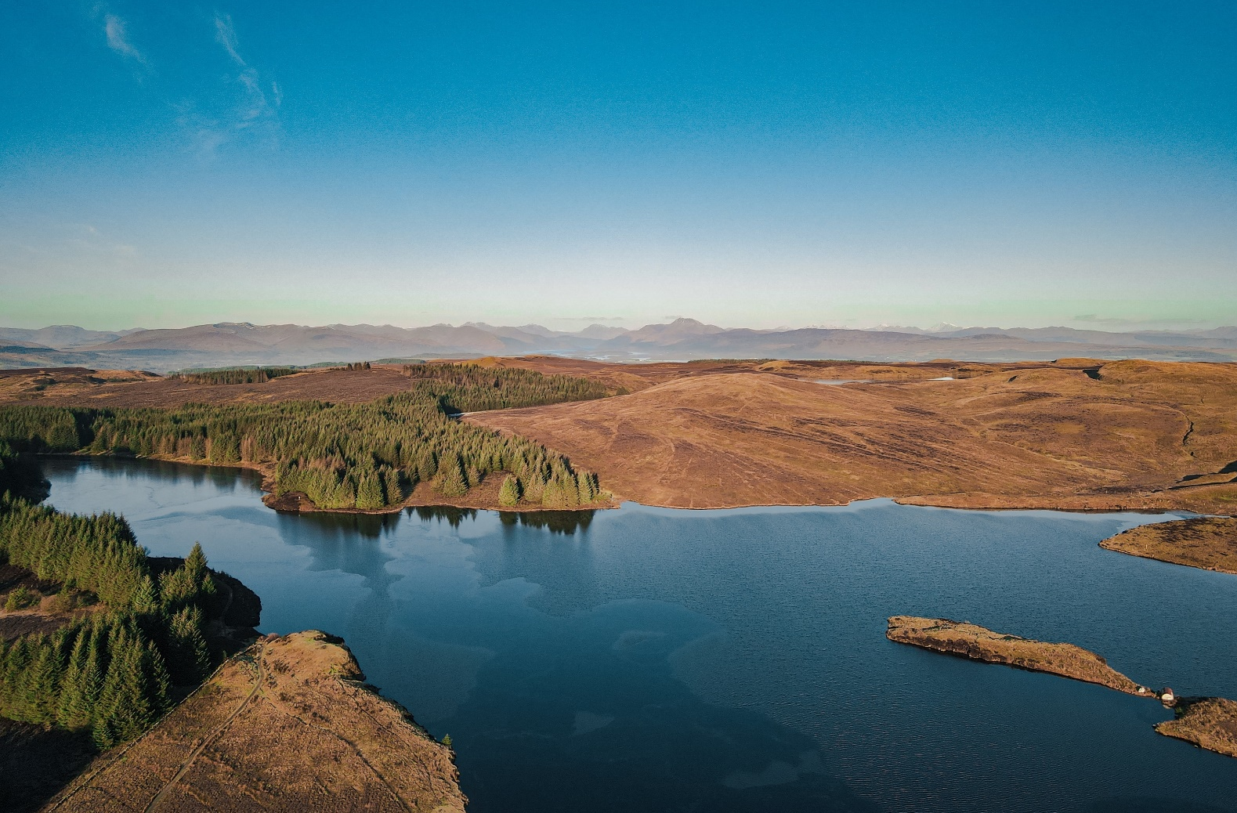
Starter activity
Think of a body of water near you – it could be a river, loch or beach.
What do you do there?
Not all risks are easy to see which can be very dangerous.
Can you think of any?
Notes:
Introduce the starter activity.
Ask the young people to think of a body of water near them – it could be a river, loch or beach. Ask them, what do you do there?
Suggest to the young people that they can think about the challenge question after they have completed the starter activity: Not all risks are easy to see which can be very dangerous, can you think of any?
Later on in the workshop hidden dangers will be discussed, however for reference hidden dangers can include: the depth, temperature and power of the water, and hidden dangers such as rocks, rubbish and broken glass.
Note: discussing local bodies of water will make the workshop relevant and engaging for the children and young people.

Slide 4
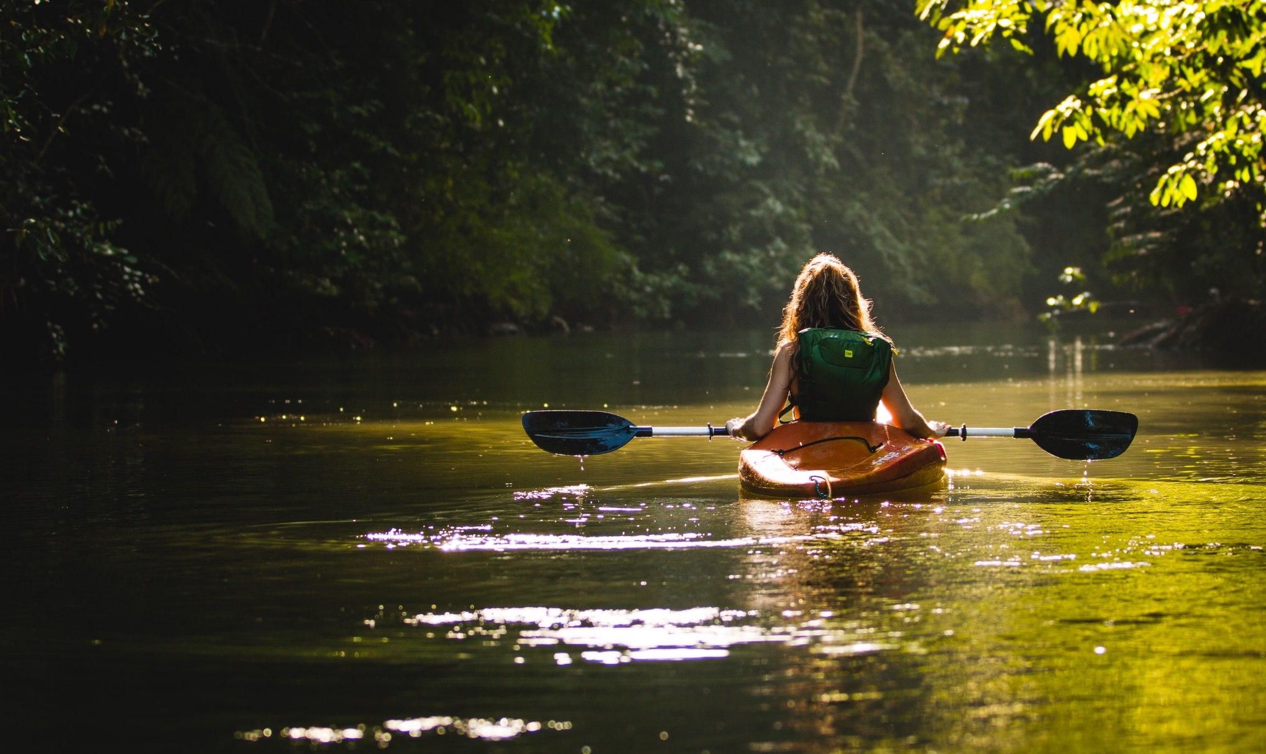
Learning objectives
To develop an understanding of the dangers of water, in particular the effects of cold water shock.
​
To develop an understanding of how you can keep yourself and others safe around water, and how to respond in an emergency.
Notes:
This slide covers the learning objectives. The workshop is designed to:
To develop an understanding of the dangers of water, in particular the effects of cold-water shock.
To develop an understanding of how you can keep yourself and others safe around water, and how to respond in an emergency.

Slide 5
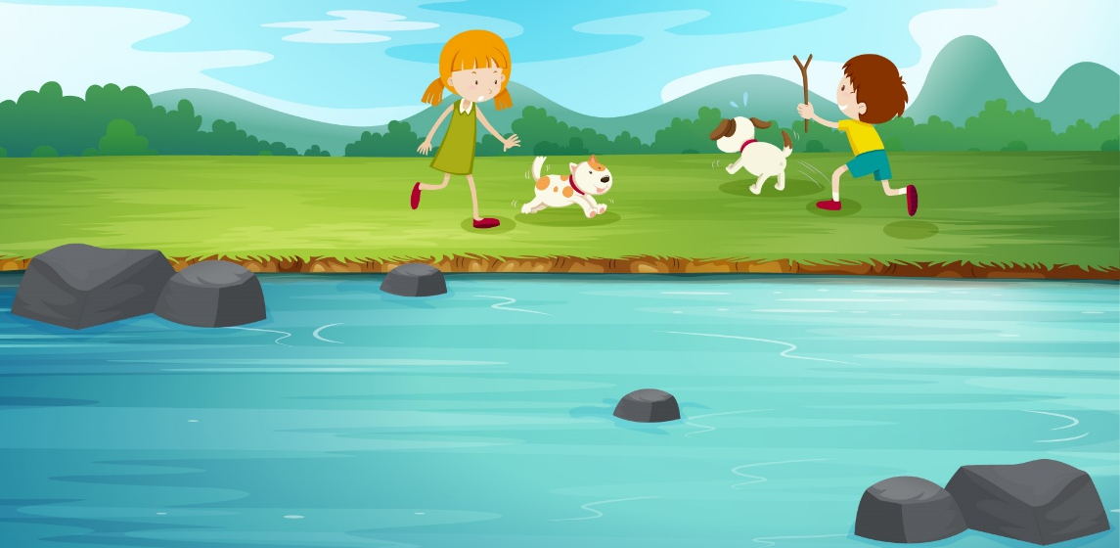
Activity 1 Stop and Think, Spot the Dangers
You are taking your dog on a walk by the river
It’s important to Stop and Think, Spot the Dangers when you’re near water.
Can you see any dangers in this picture?
What dangers might be hidden?
It’s important to identify where you are and if there is rescue equipment near you. How could you get help if you got into trouble here?
What kind of dangers would you find at the coast that you wouldn’t find at inland waters?
Notes:
Introduce Activity 1 which introduces the first part of the three-step code, Stop and think, spot the dangers.
Ask the young people to consider this scenario: you are taking your dog on a walk by the river (refer to image on the slide)
It’s important to Stop and think, spot the dangers when you’re near water.
Present the young people with the following questions:
Can you see any dangers in this picture? (the water could be deep/cold/fast, the water is just a step from the edge/the edge could be slippy/unstable)
What dangers might be hidden? (there could be rocks/hidden objects under the water, one of the dogs could go into the water and need rescued)
It’s important to identify where you are and if there is rescue equipment near you. How could you get help if you got into trouble here? (look for safety signage/information boards/public rescue equipment. If nothing is present, then always have a mobile phone to use in case of emergency)
Suggest to the young people that they consider the challenge question: What kind of dangers would you find at the coast that you wouldn’t find at inland waters? (offshore/strong winds, changing tide, rip currents)
Note: you may wish to allocate thinking time and discussion, and then ask for feedback on each question, or alternatively you can talk through each question.

Slide 6
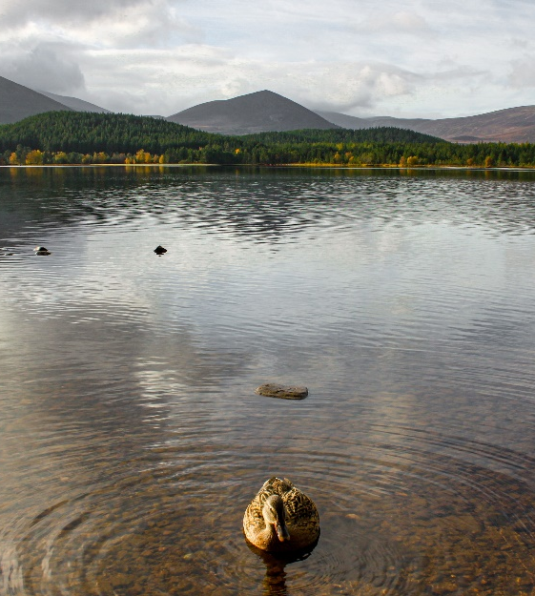
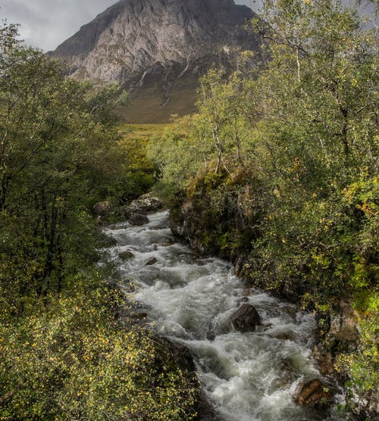
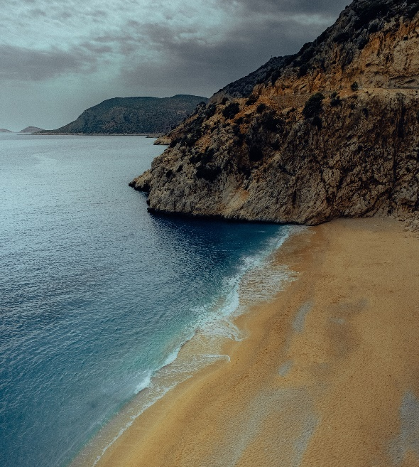
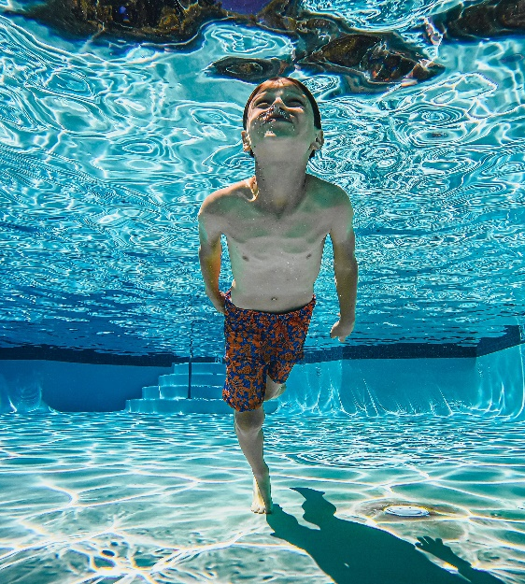
Activity 2
Where do accidents happen?
Accidents happen in different areas of water. How do these differ from each other and what do we need to consider in the different locations?
Notes:
Introduce activity 2: Where do accidents happen?
Explain that accidents happen in different areas of water. Ask the young people to look at the images and think about how they differ from one another and what do they need to consider in the different locations?
Factors to consider:
Beach: Tides, currents, rip current, temperature of the water, cold-water shock, hidden dangers (broken glass, rubbish)
Loch: temperature of the water, cold-water shock, hidden ledges or sudden drops, hidden dangers, the edge can give way.
Swimming pool: warmer water, lifeguards, controlled temperatures and conditions
River: fast flowing water, temperature, cold-water shock, hidden dangers, power of the water, the edge can give way

Slide 7

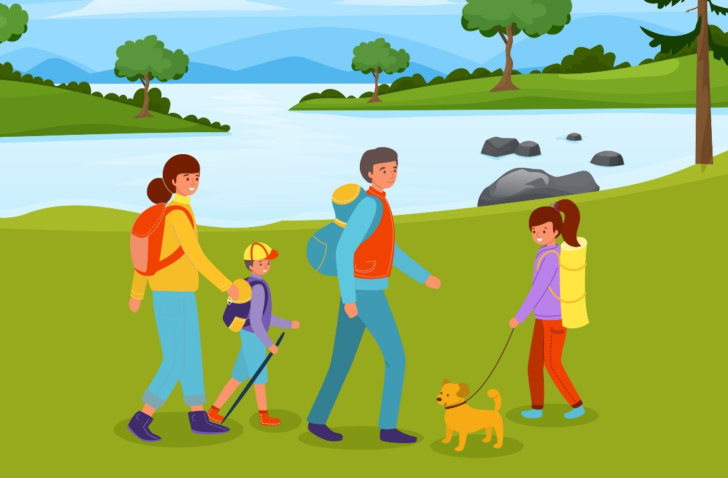

Stay with your family
Planning for a day out can help you keep safe: what could you bring with you?
Why are you safer in a group?
Why is it important to look out for others when near water?
Notes:
Introduce activity 3: this activity introduces the second part of the three-step code, Stay together, stay close.
Ask the young people to take a look at the image on the slide featuring a family walking their dog near a loch.
Talk through the messaging at the bottom of the slide: it’s important to always tell someone where you are going, and when you’ll be back. Be prepared for your trip and plan your trip before you go. Check the weather forecast in advance and wear the right clothing. You should also bring a mobile phone with you.
Ask them to think about the following discussion questions:
Why are you safer in a group? (others can help/raise alarm in case of emergency)
Why is it important to look out for others when near water? (varying levels of ability/experience/knowledge of dangers)
Planning for a day out can help you keep safe: what could you bring with you? (mobile phone, correct equipment/safety equipment, suitable clothing for the weather, food and drink, check the forecast)
Note: you may wish to ask them to ‘think-pair-share’ (by discussing the questions in a pair or group, then feeding back to the class/assembly).
Alternatively you may wish to talk through the questions as a group, and ask for hands up for feedback.
Note: you may wish to bring props with you, such as a jacket, jumper, water bottle, sun cream, a waterproof phone pouch, a life jacket or another piece of equipment etc, as this will encourage discussion and thinking on the topic of being prepared.

Slide 8



Think about the following questions while
you watch the video…
What could have helped the person in the water?
What else could have identified the location?
Why should you never go into the water to help someone?​
Notes:
Explain that we will be listen to a short audio clip of an example 999 call, which will introduce the third part of the three-step code, In an emergency, call 999.
After playing the clip, introduce the three questions:
What else could have identified the location? (Answer: safety signage near water should have location information to assist emergency services in locating the area in question)
What could have helped the caller to help the person in the water, whilst he awaited the arrival of the fire service? (Answer: public rescue equipment such as life ring, throwline or is not available a long stick or a football to help him float. Important: do not put yourself in danger whilst using any of these items)
Suggest that the young people can consider the challenge question after they have thought about the main discussion questions:
Challenge question: why should you never go into the water to help someone? (you put yourself in danger and potentially make the situation worse)
Note: as part of the ‘In an emergency, call 999’ message, it is important to state that you should never go into the water help someone – this includes a friend, family member or pet. Instead young people should be encouraged to call 999 immediately, stay away from the water and while they are waiting for the emergency services to arrive they can encourage the person in the water to:
Remain calm
Float on their back (like a starfish)
They can use lifesaving equipment to help the person
If there is not lifesaving equipment available, they can use a football (or something else that floats) and throw this to the person in the water
Tie jumpers together, or use a rope to help the person.
Young people should be aware that they will not get into trouble for calling 999 if they believe someone is in the water and struggling.

Slide 9
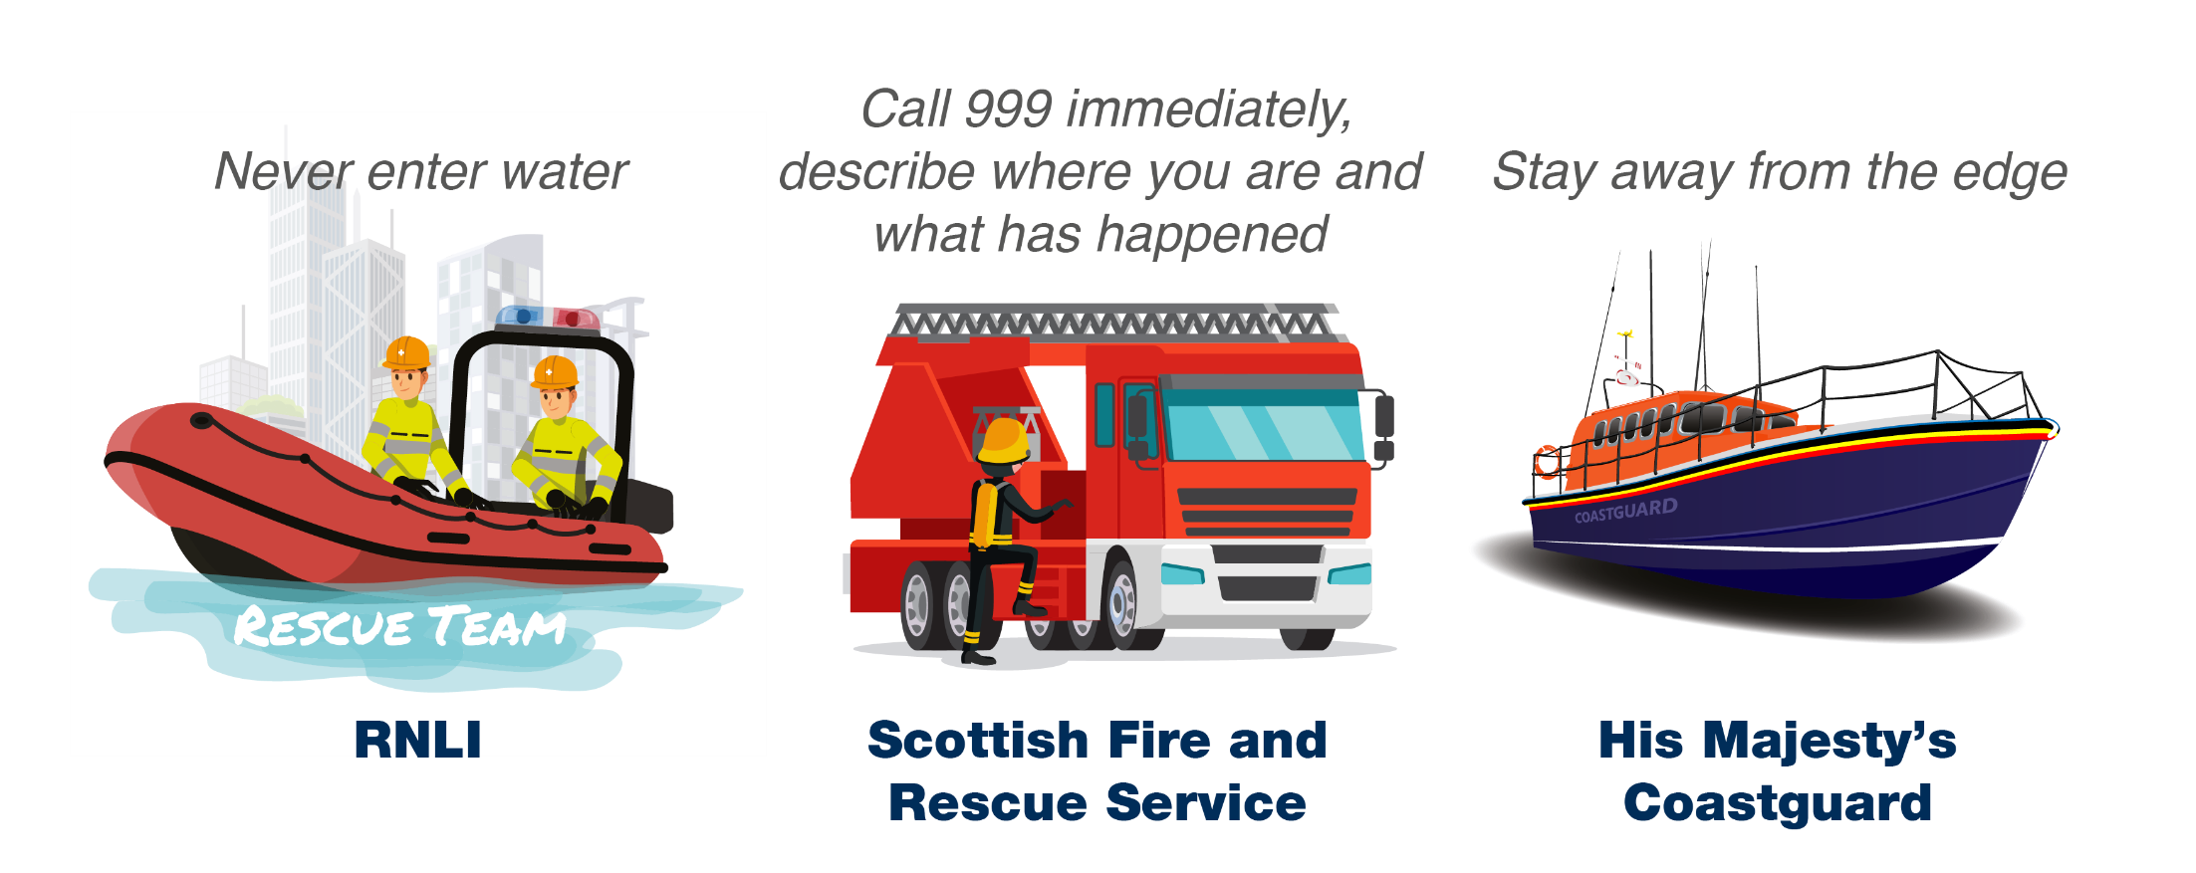
Activity 4
What to do if you see someone in trouble in the water
We respond in an emergency:
Notes:
Introduce activity 4: We respond in an emergency:
Talk through the slide, introducing the different emergency services that respond to incidents in or near the water. They include:
The RNLI: the RNLI say you should never go into the water to help someone.
The Scottish Fire and Rescue Service: they say to Call 999 immediately, and describe where you are and what has happened.
His Majesty’s Coastguard: if someone is in the water, always stay away from the edge.

Slide 10
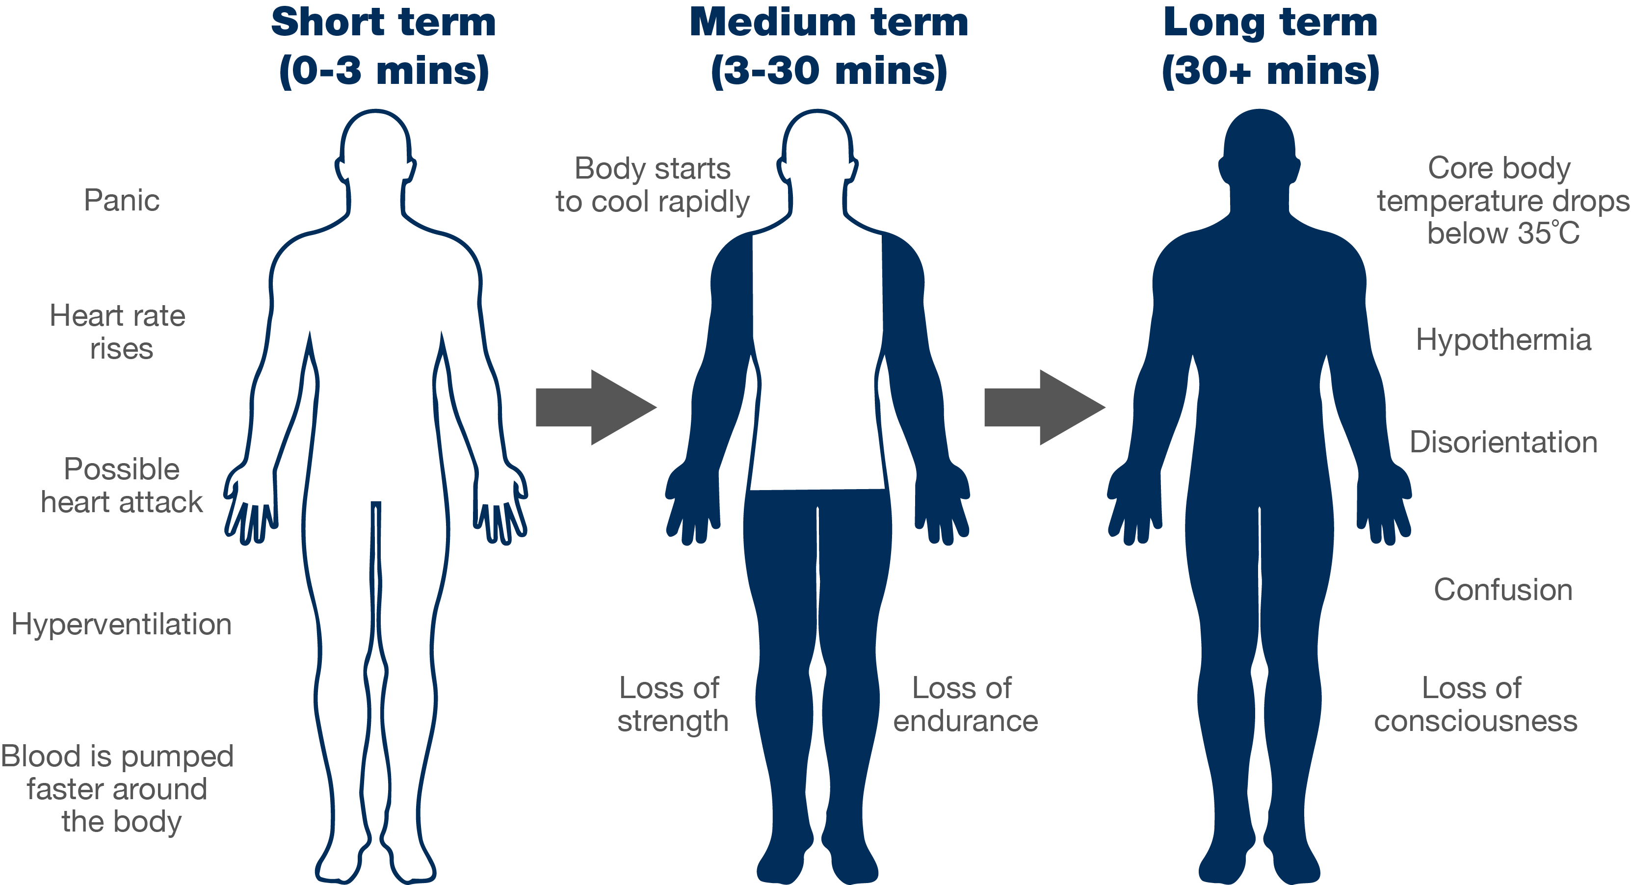
Cold water shock
Notes:
Introduce this slide which covers the different stages of ‘cold-water shock:
This slide shows how cold-water shock affects your body at various stages.
You may wish to ask the young people if they have ever fallen into or jumped into water: how did this feel? Did they panic? Did they get a fright?
Scotland’s waters are cold year-round: anything below 15°C is defined as cold water and can seriously affect your breathing and movement, so the risk is significant most of the year.
The average temperature of the sea around the UK and Ireland is about 12°C.
Challenge questions
Is anyone surprised by this?
What would you do to calm yourself down if you fell into cold water? (Float with arms and legs extended and head back and stay floating until your breathing is calm and you can swim to safety or call for help)
Why is it dangerous to panic when you’re in water? (You could inhale water if breathing quickly and also tire yourself out – it’s much better to float until the feeling of panic has passed)
How could floating on your back save your life? (It allows your body time to get over the initial feelings of cold water shock and then call for help of swim to safety)

Slide 11
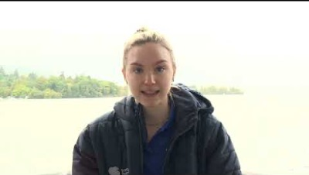




What should you do if you get into trouble in the water?
Cold water shock with Paralympic Athlete Toni Shaw
How would you react?
Key points:
Instead of panicking, Float on your back
Call 999 if you have a mobile on you
After you have calmed down shout loudly for help
If you can – attempt to swim to shore or find something that floats
What emotions might you feel?
How would your body feel?
Notes:
We will now discuss what to do if you get into difficulty in the water.
Toni Shaw is a Paralympic Athlete swimmer. Explain that they will be listening to Toni Shaw’s advice on what to do if you get into difficulty in the water.
Refer to the drawing of the person in the water floating on their back.
You may wish to go through the questions.
How would you react if you fell into cold-water?
What emotions might you feel?
How would your body feel?
Key points to recap:
Call 999 if you have a mobile on you
Instead of panicking, Float on your back
After you have calmed down shout loudly for help
If you can – attempt to swim to shore or find something that floats
Note: if you have the space, you can encourage the young people to stand up (or lie down on the floor if appropriate) and ‘practice floating’.
Further information on floating:
Fight your instinct to swim and instead float on your back for 60 seconds. Tilt your head back so your ears are submerged. Relax and try to breathe normally. Move your hands to help you stay afloat. It's OK if your legs sink, we all float differently.

Slide 12
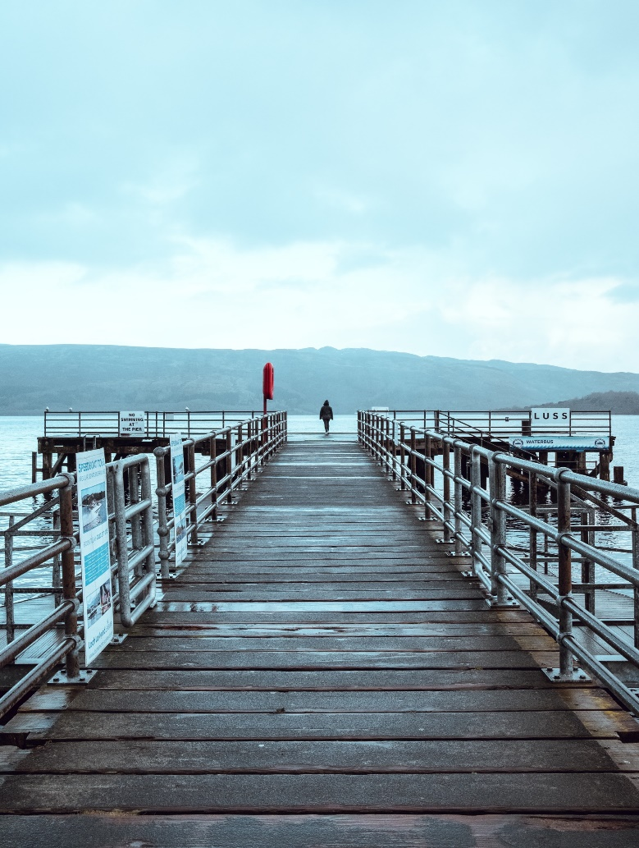
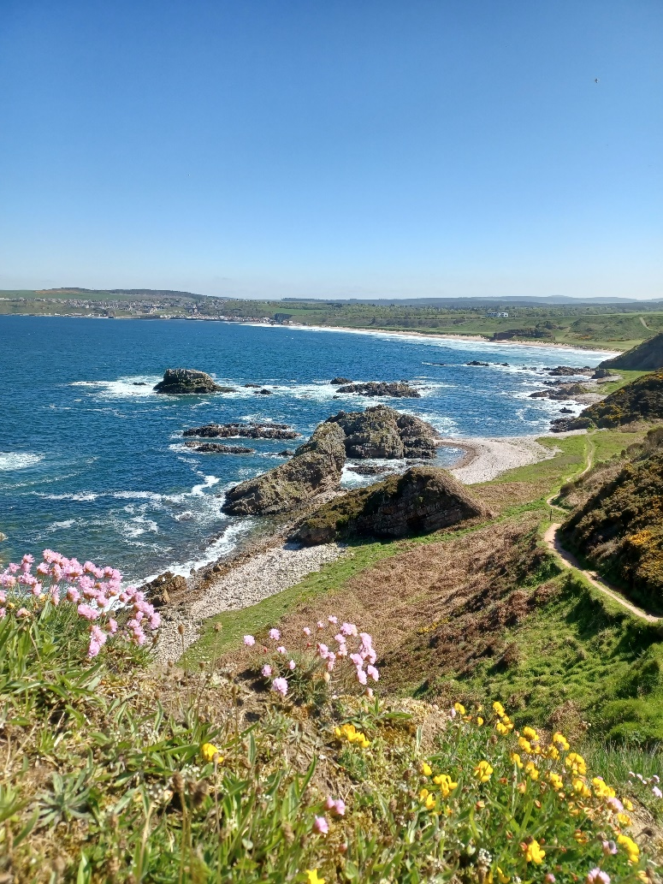
Activity 6
Have you learned the Water Safety Code?
Think of that same body of water again.
Not all dangers are visible: think of two that you can’t always see.
What two actions should you take if you saw someone in trouble in the water?
What should you do if you found yourself in water unexpectedly?
What one thing would you tell a friend about how to stay safe around water?
Notes:
Introduce activity 6: have you learned the Water Safety Code?
Ask the young people to think back to the same water they thought about at the beginning of the session. Ask them to consider the following questions
Not all dangers are visible: think of two dangers that you can’t always see. (depth/temperature/speed of water, hidden objects such as rocks, rope,
What two actions should you take if you saw someone in trouble in the water? (call 999 and give accurate information and situation and location, use public rescue equipment)
What is one thing would you tell a friend about how to stay safe around water? (follow the three steps of the water safety code)
Note: you may wish to ask them to ‘think-pair-share’ their answers, or go through the questions as a group, taking feedback.

Slide 13
Notes:
Recap over the three-step code:
Stop and think, spot the dangers
Stay together, stay close
In an emergency, call 999.
You may wish to ask the young people if they have any questions. You also may wish to ask them some of the questions below which will help to gauge their understanding of the code:
Why should you never attempt to enter the water to help someone?
Who number do you call in an emergency?
Which emergency service should you ask for when you dial 999?
Which three things can you do to stay safe near water?
What is it important to stay together when near water?
Why can some dangers be hidden?
If you fall into cold water, what should you do?
Which three pieces of advice would you give someone about water safety?

Slide 14

This resource is based on the hard work of Gillian Barclay and the Fife Water Safety Group

