Slide 1
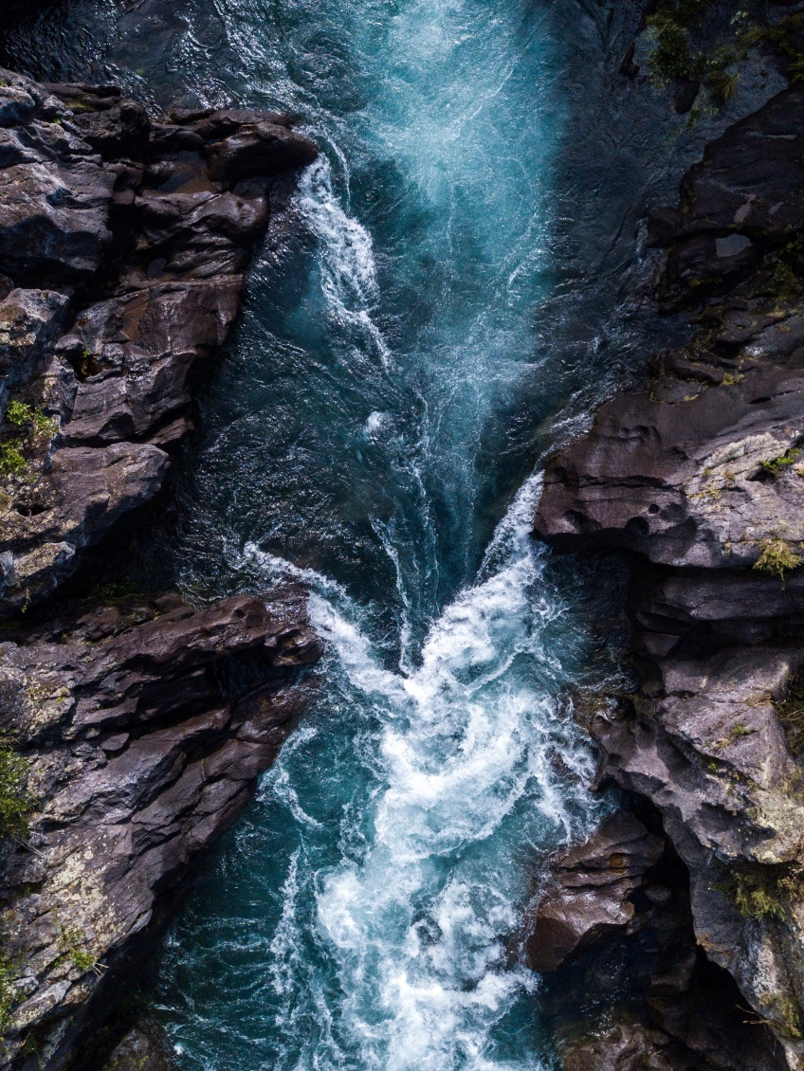

Water Safety Lesson:
Senior Phase
Learning
Objectives
To understand how to predict, assess and manage risk in different water environments.
To understand strategies that will keep me (and others) safe in and around water.

Slide 2
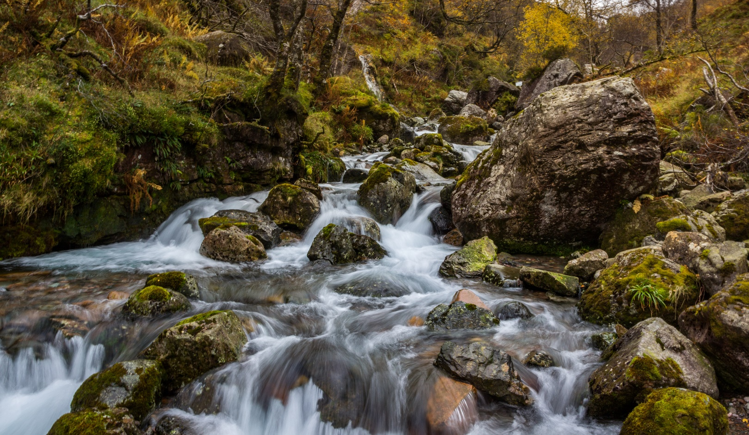
Activity 1 (Starter)
“I am only responsible for myself when near water.”
1 = totally agree
10 = totally disagree
Think about the statement then write down your number (that reflects your point of view). Be prepared to justify your answer.
What physical dangers does open water pose?
Are there any specific challenges in relation to Scotland’s waters?

Slide 3
Activity 2 Stop and Think, Spot the Dangers
Think about a local body of water.
In pairs or groups, discuss where it is and what dangers there might be.
Can you thinks of situations where people would be in and around the water in Scotland?
What do you think are the key challenge in relation to water safety?
Are there any specific behaviours children and young people may display in or around water?

Slide 4
Activity 3 Stop and Think, Spot the Dangers
‘Conver-stations’
Discussion questions
Think of a local body of water (a loch, river, reservoir, pier or beach). Do you think it’s safe there? What dangers could there be? Do you think people behave safely there? What sort of risks do people take? Hint: some risks or dangers are not obvious.
I never take risks around water. Do you agree with this statement?
What is a risk? Why do people take risks?
I feel confident in my ability to say no if someone encourages me to do something risky in or around water. Discuss.
In groups, you will need:
A scribe and a spokesperson

Slide 5
Activity 4 Stay Together, Stay Close
“I feel confident
in challenging dangerous behaviour I see around water.”
Take your time thinking about the statement – make sure you can justify your answer!
What are the specific challenges for young children?
How does the water safety message need to be adapted?

Slide 6

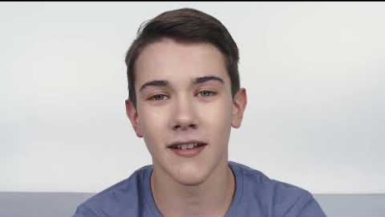
Would you have entered the water?
What could you have said to prevent him entering the water?
Why is it important to never enter the water to help someone?
What are the appropriate steps to take if someone gets into trouble in the water?
Notes:
https://youtu.be/9XGtNsRUSAU?si=n1M1UKexH0SsTq0v

Slide 7
Activity 5 Scenarios: In an Emergency, Call 999
Discussion questions
What happened?
Who was there?
What were the hazards?
How could they have stayed safe?
Did they stay together in this scenario?
What could they have done differently to have changed the outcome?
What should happen next in the scenario?
Part A:
In groups you will be studying a scenario. Study the scenario to answer the following questions.
In groups, you will need:
A scribe and a spokesperson
In the scenario you’ve just read, were the people prepared for the water? Which dangers did they not anticipate?

Slide 8
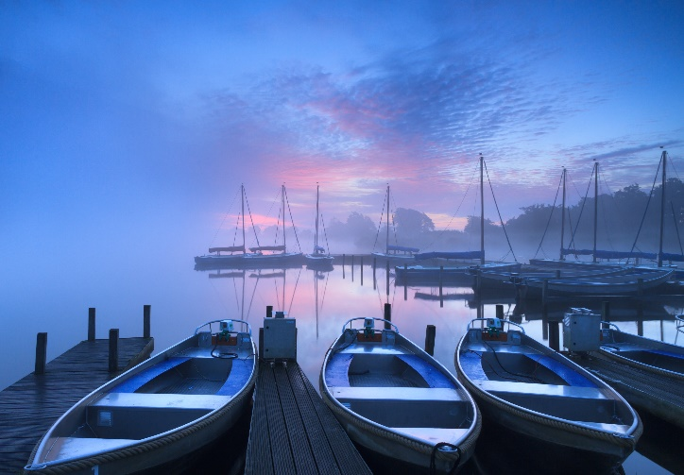
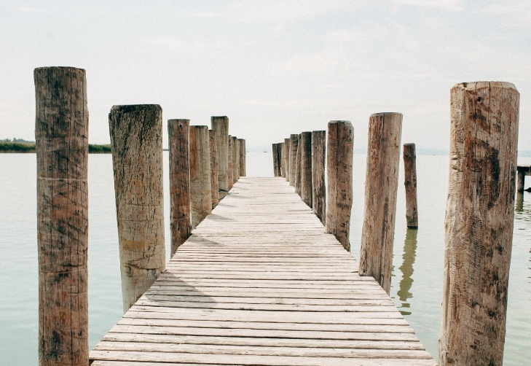
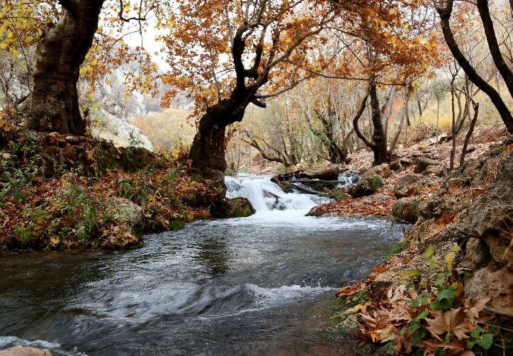
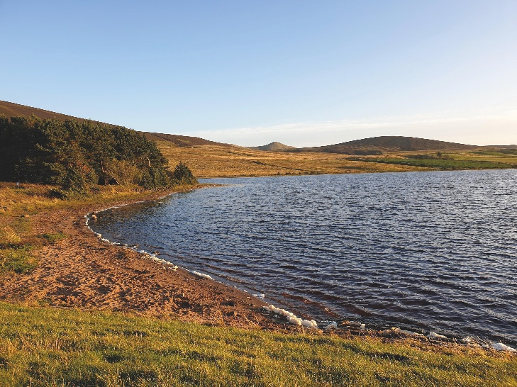
Scenarios: Feedback
Part B:
The spokesperson should now provide feedback to the class.
Dark winter’s evening by a harbour
Warm summer’s day by a pier
Reflecting on the other groups’ scenarios, can you add anything to their feedback or suggest other tips or points?
Autumn River
Loch on a summer’s day

Slide 9
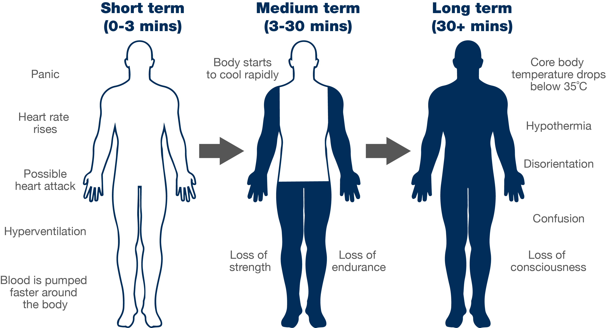
Cold water shock

Slide 10
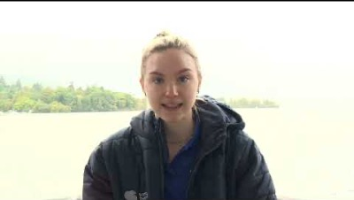

Fight the urge to swim and instead float on your back until you can either swim to shore or shout for help.
The steps to take in an emergency:
Call 999
Calmly explain the situation to the operator, including where you are, what state the casualty is in
Keep an eye on the person in the water – reassure them that
help is coming and try to encourage them to float on their back
If possible, find something near you that you could use to help (life saving equipment, or a rope, branch, or anything that floats, for example, a football).
Notes:
https://youtu.be/Wf_LSdw4dvs?si=AWpKaBe0-MueHd5f

Slide 11
How to stay safe and have fun in and around the water

