Slide 1
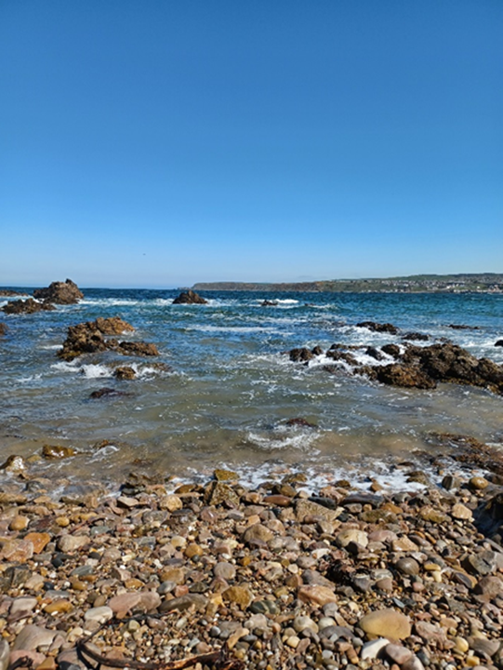

Water Safety Lesson:
Third / Fourth Level
Learning
Objectives
To develop an understanding of the dangers of water, in particular the effects of cold water shock.
To develop an understanding of how you can keep yourself and others safe around water, and how to respond in an emergency.

Slide 2
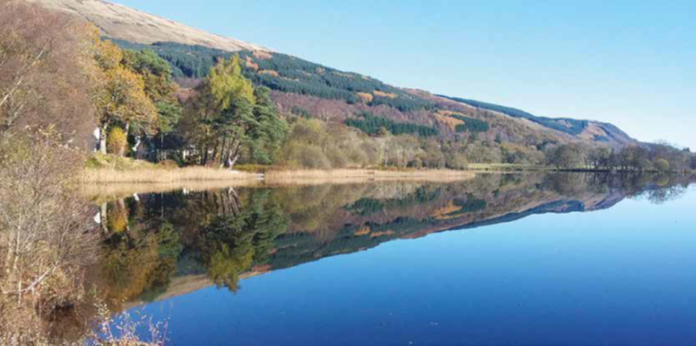
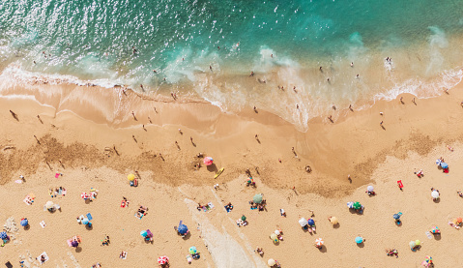
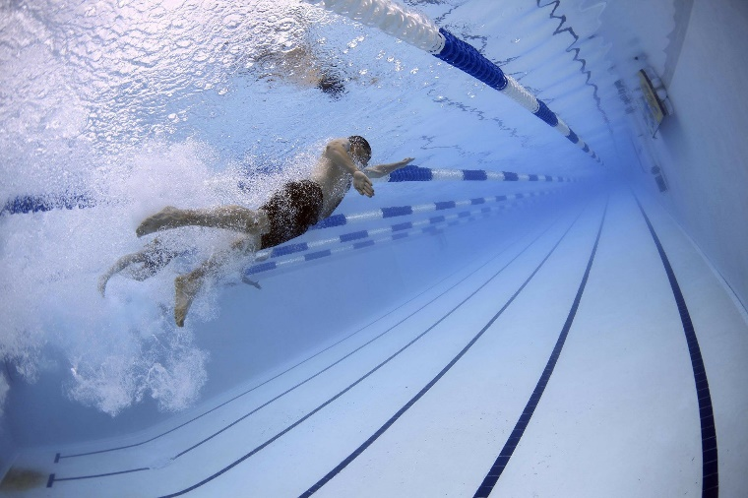
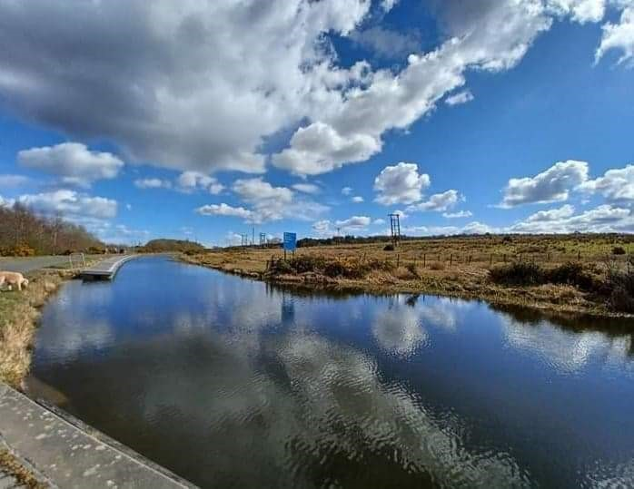
Activity 1
In a pair or group, choose
a picture.
What do you see?
Do you ever visit a place like this? Where is it?
Do you feel safe there?
What might the dangers be?
1.
2.
3.
4.
What are the differences between swimming in a pool and in the sea?
Notes:
First Slide: Activity 1
This slide should be shown as students enter the assembly hall or classroom. Ask students to spend a couple of minutes thinking about a place local to them (or somewhere they have visited) where there is open water.
You could give them an example of a local loch, river or beach, in order to set the scene and place the topic into a meaningful and relatable context.
‘Ask students the following questions:’?
What do you enjoy about the water?; Have you every felt unsafe near or in water?; How might water be dangerous?
Ask pupils to think about the challenges: What are the differences between swimming in a pool and in the sea?
Why are some hazards not visible or clear to see? What are they?
Why can water be dangerous?

Slide 3

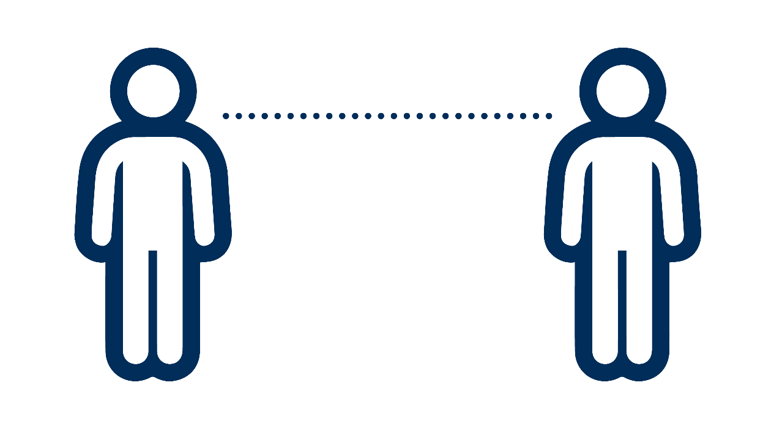
Activity 2 Stop and Think, Spot the Dangers
“I never take risks around water.”
1 – totally agree
10 – totally disagree
Stand near me if you agree, away from me if you disagree.
Be prepared to explain your answer.
Can you think of a time you felt pressured to take a risk?
What would you do if someone encouraged you to act dangerously near water?
Notes:
Read out the statement and explain to pupils that they need to think carefully about it.. They need to be able to justify their answer.
1 = totally agree
10 = totally disagree
Take feedback from a couple of students. Ask them to share and compare their risks. Would one student do what the other did?
Key terms:
Hazard: ‘something with the potential to cause harm’
Risk: ‘the likelihood of that potential harm happening’

Slide 4

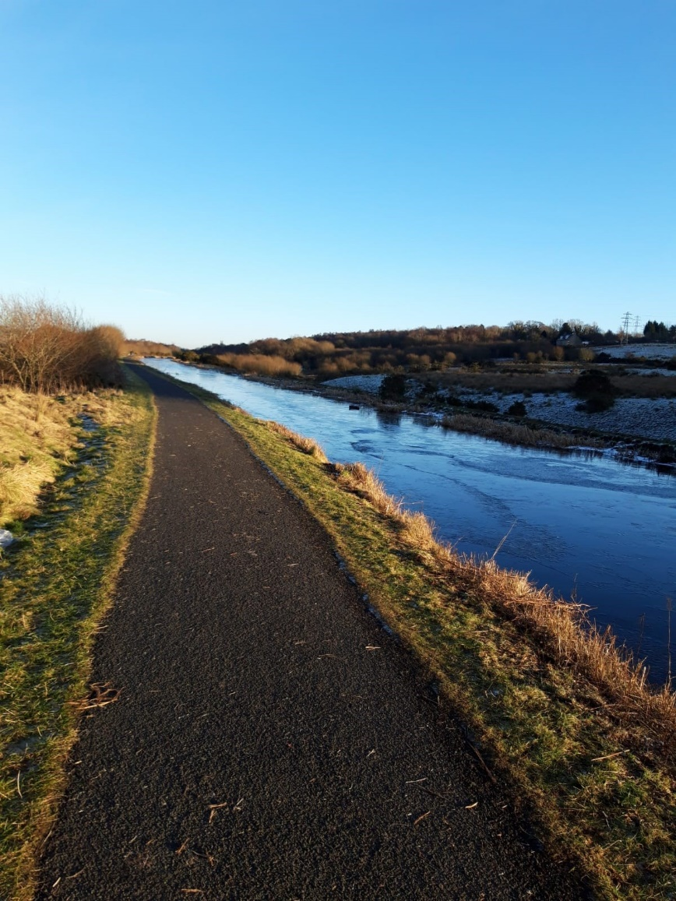
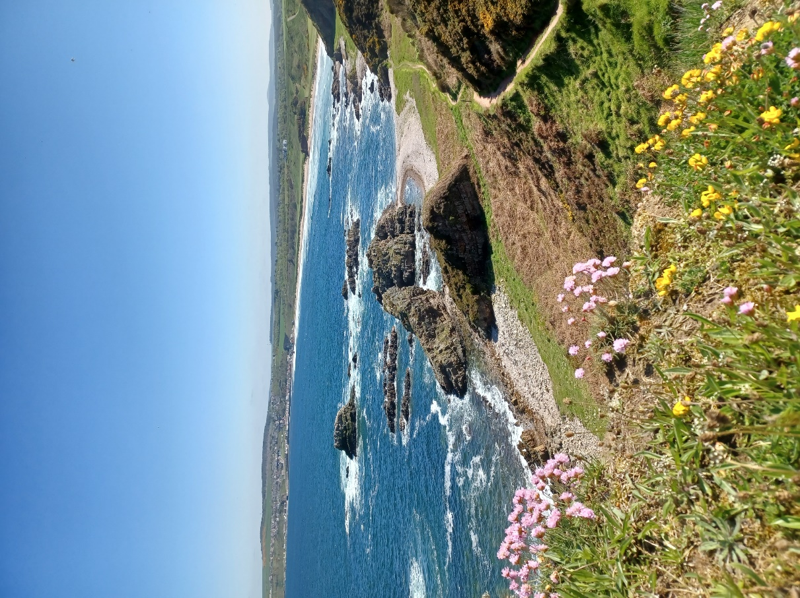
Activity 3
Choose A or B.
As a group discuss:
What dangers could there be?
Are all dangers easy to see?
What could you do to stay safe?
What would you bring with you?
A) It’s a sunny but windy day.
You are paddling in the shallow water. Your little brother hasn’t
learnt to swim yet. Your parents
are on the beach.
B) It’s a cold winter’s afternoon.
You and two friends are walking
your dog next to the river. It’s getting dark and there are no streetlights. There is a café nearby.
Notes:
Activity 3
Place pupils in groups or pairs. Ask them to choose and read either scenario A or scenario B, then answer the questions in the box. Ask them to feed back the answers to the class.
Challenge questions (for teacher to ask pupils):
What water safety advice would you give to someone younger?
Why does staying with a parent/guardian/responsible adult, or in a group, make you safer?

Slide 5
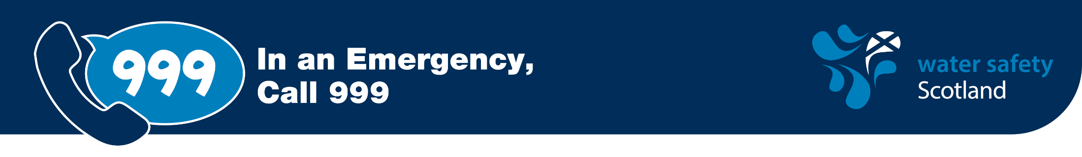
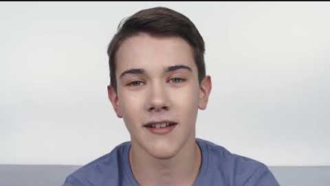



Think about the following questions while
you watch the video…
Why do you think he went into the water?
What would you have done to help him?
Would you have gone into the water?
He thought it was safe to go in: what dangers could he not see?
Why should you never go into the water to help someone?
Notes:
Note: Please issue a safety warning before playing this video.
Note: This video will be replaced with a Scottish version, currently being created with Scottish Tech Army.
Read the questions before playing the video. Let pupils know that although this is not a true story, it is sadly based on tragedies that have occurred across Scotland.

Slide 6
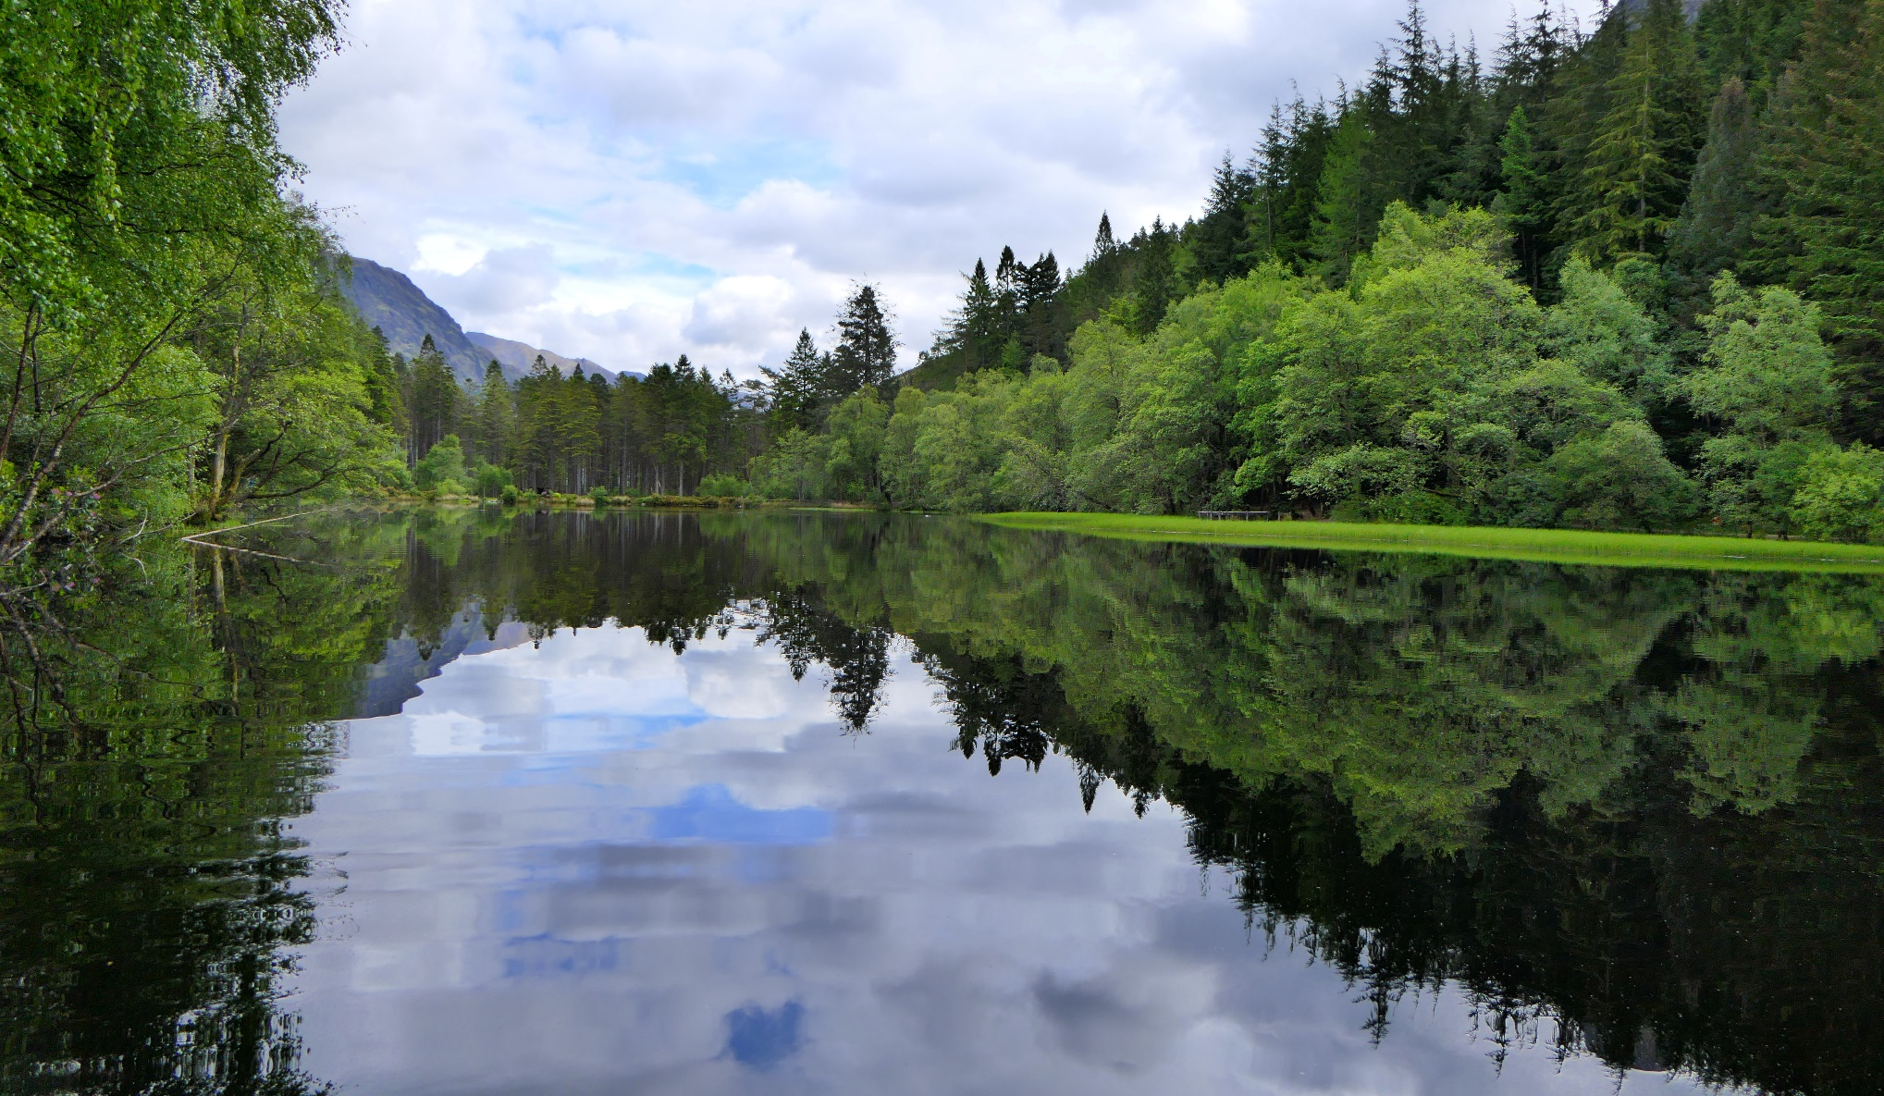
Activity 4 Cold water shock: cold water investigation
Notes:
Activity 4
Youwill need the following:
Bucket or bowl
Cold water (with ice cubes if available)
Paper towels, or towel, to dry hands
Pen and paper
Timer
Ask for two volunteers. Ask them to each write their name on a piece of paper. Then, get them to place one of their hands (the one they write with) into the water. Ask the class how long they estimate they can keep their hands in for. And ask the volunteers how long they estimate they can keep their hands in for. (Start a timer.)
Ask the volunteers how it feels, what sensations they are feeling.
Then, ask them how they’d feel if their whole body was in the water. What emotions might you feel? Would you feel scared, disorientated?
Ask them what they would do in that scenario.
The same volunteers then need to write their names on a piece of paper and explain if it felt different. Was it difficult to do? Were their hands shaking? Why might that be?
Note: If they fell into water, they should:
Try not to panic
Not attempt to remove clothing
Not attempt to to swim. Instead, they should float on their back for 60 seconds. This will allow them to calm down, get used to the temperature of the water and think about what to do next (swim or shout for help).

Slide 7
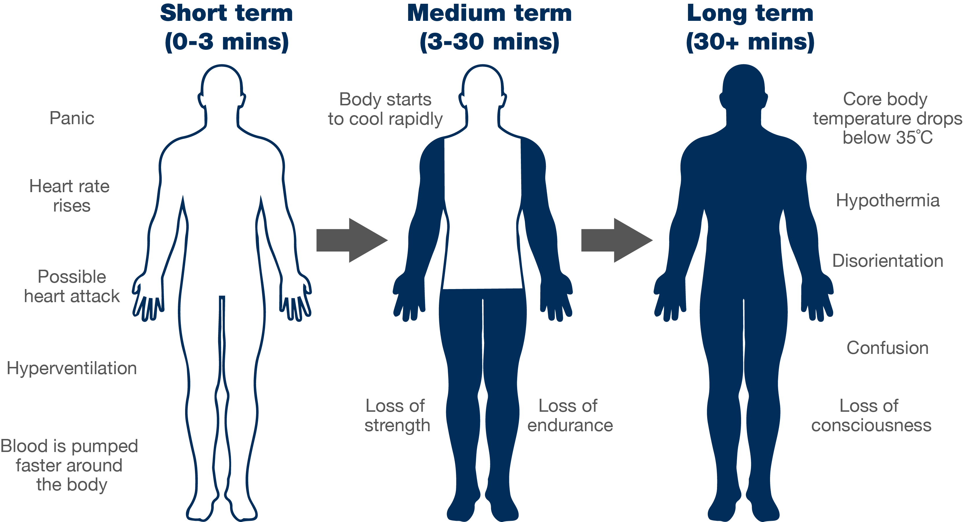
Cold water shock
Notes:
This slide demonstrates how cold water shock affects your body at various stages.
Challenge questions
Is anyone surprised by this order?
What would you do to calm yourself down?
How could calming down increase your chance of survival?
How could floating save your life?
Anything below 15°C is defined as cold water and can seriously affect your breathing and movement, so the risk is significant most of the year.
The average temperature of the sea around the UK and Ireland is about 12°C.

Slide 8





Float to Live
How would you react?
What emotions might you feel?
How would your body feel?
Notes:
What is the typical temperature of a swimming pool? 29°C and that still feels chilly when you first enter
The water around our coasts or in rivers rarely gets above 15°C, so cold water shock is always likely
Ask the pupils : How could floating have helped the boy in the previous video?
Float to Live
Instead of panicking and trying to swim, float on your back for 60 seconds. If there’s space, ask the pupils to simulate ‘floating’ on their backs on the floor. Act like a ‘starfish’ – legs and arms out, moving arms in the water slowly. This will help calm you down, get your body used to the temperature of the water and give you time to think. After 60 seconds, either try to swim to something (shore, something that floats), or shout for help (count down from three and ask pupils to put one hand in the air, waving, and shouting ‘help’ loudly).
Encourage pupils to use their local pool to practice floating.

Slide 9


Activity 5
Look back at the first image you chose
What dangers might there be?
If you saw someone in trouble, what would you do?
If you found yourself in water unexpectedly, what would you do?
How could you have fun safely here?
2.
1.
1.
3.
3.
4.

Slide 10
How to stay safe and have fun in and around water
Notes:
To gauge understanding, ask pupils:
Why should you never attempt to enter the water to help someone?
Who do you call in an emergency?
Who do you ask for when at the beach? At a loch?
Which three things can you do to stay safe near water?
Why can some dangers be hidden?
If you fall into cold water, what should you do?
Which three pieces of advice would you give someone about water safety? Should these bullets be in the PowerPoint slide, in the Notes?

Slide 11

This resource is based on the hard work of Gillian Barclay and the Fife Water Safety Group

